Slide 1

Numerical Computing Project
image filters using convolution
operations and mathematical kernels
Submitted to: Sir Farrukh Shahzad
Name: Uzair Ahmed Nasir - 357

Slide 2

Introduction
In this project, we explore the concept of image filtering using convolution. Image filtering is a fundamental technique in image processing that helps enhance or modify images by applying various filters.
Purpose: The purpose of this project is to implement image filtering algorithms from scratch using the Julia programming language. By understanding the mathematical concepts behind image filtering, we gain insights into how these algorithms work and their impact on image quality and features.

Slide 3
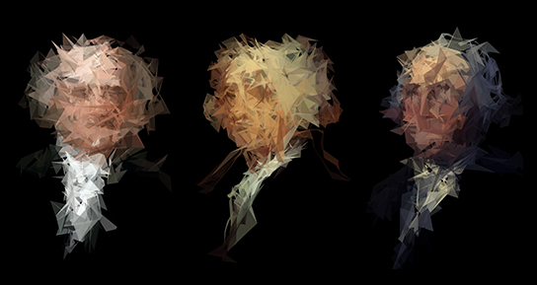
Program Execution Live Demo
This Photo by Unknown author is licensed under CC BY-SA.

Slide 4

Mathematical Tool - Convolution
Convolution: Illuminating Image Transformation
Convolution: A fundamental mathematical operation in image processing.
It involves overlaying a kernel on an image and performing a weighted sum of pixel values.
Kernel: Unveiling the Magic of Matrix Mathematics
The kernel acts as a filter, affecting the contribution of neighboring pixels to the final output.
Kernels are mathematical matrices that influence the outcome of convolution.
Different kernels accentuate or suppress specific image features.

Slide 5
Mathematical Tool - Convolution
Transforming Images: Unraveling the Mathematical Process
Convolution applies the kernel to each pixel in the image, calculating a weighted sum of neighboring pixels.
This process emphasizes or suppresses image features, leading to various transformations.
Convolution Unleashed: Transforming Pixels into Gold
Convolution unlocks the artistic and scientific potential of images through mathematical operations.
Pixels are transformed using mathematical tools, combining art and science.
Convolution empowers us to harness the hidden potential within each pixel.

Slide 6

QnA
If you have any questions, please don't ask

